Slide 1

CSCE 120/121 Introduction to Program Design & Concepts
Dynamic Memory
Dr. Tim McGuire
Grateful acknowledgment to Dr. Philip Ritchey and Dr. Michael Moore for some of the material on which these slides are based.

Slide 2
Dynamic Memory Allocation
Can allocate storage for a variable while program is running
Computer returns address of newly allocated variable
Uses new operator to allocate memory:
double *dptr = nullptr;
dptr = new double;
new returns address of memory location

Slide 3
Dynamic Memory Allocation
Can also use new to allocate array: const int SIZE = 25; arrayPtr = new double[SIZE];
Can then use [] or pointer arithmetic to access array:
for(i = 0; i < SIZE; i++)
arrayptr[i] = i * i;
or
for(i = 0; i < SIZE; i++)
*(arrayptr + i) = i * i;
Program will terminate if not enough memory available to allocate

Slide 4
Releasing Dynamic Memory
Use delete to free dynamic memory:
delete fptr;
Use [] to free dynamic array:
delete [] arrayptr;
Only use delete with dynamic memory!

Slide 5
Recall: Memory Layout
Memory
Code
Static Data
Heap / Free Store
Stack and heap grow toward each other.
Heap / Free Store
Stack
Stack

Slide 6
Stack
Recall:
As stack grows / shrinks, items are automatically cleared from Memory
i.e. when a function ends, all of its objects (variables) are cleared from Memory
Sometimes we want objects to live on after a function is finished.
Put on the Heap / Free Store

Slide 7
Heap aka Dynamic Memory
How to use the heap?
Use ‘new’
Gets memory from the heap
Returns a pointer
Use ‘*’ to dereference the pointer
Initialize with nullptr (i.e. 0) – See Null Pointer note in zyBook.
int i = 7; // put item on the stack
int* j = nullptr;
j = new int(11); // put item on the heap
cout << “Value in i: " << i << endl;
cout << "Address of i: " << &i << endl;
cout << “Value in j: " << j << endl;
cout << "Address of j: " << &j << endl;
cout << "*j (value at address pointed to in j): " << *j << endl;
int* k = new int[5]; // allocate an array on the heap

Slide 8
Heap
If we put something on the heap we also have to remove it.
If we don’t we might have a memory leak.
More on memory management / challenges with pointers later.
How to remove from the heap?
Use ‘delete’
Use ‘delete[]’ if deleting an array
delete j; // remove item from the heap
// j still points to the memory in the heap
// that can be a problem
Only use delete with dynamic memory!

Slide 9
Notes on new / delete
If you delete memory that has already been deleted, then an exception will likely occur.
If you delete a pointer that is set to nullptr, then no error occurs. (The delete operator is designed to have no effect when used on a null pointer.)
If you try to dereference a pointer that has been deleted, then an exception will likely occur.
So try to set the pointer to nullptr after you use delete.
Notes:
Run the dynamicArray.cpp code

Slide 10
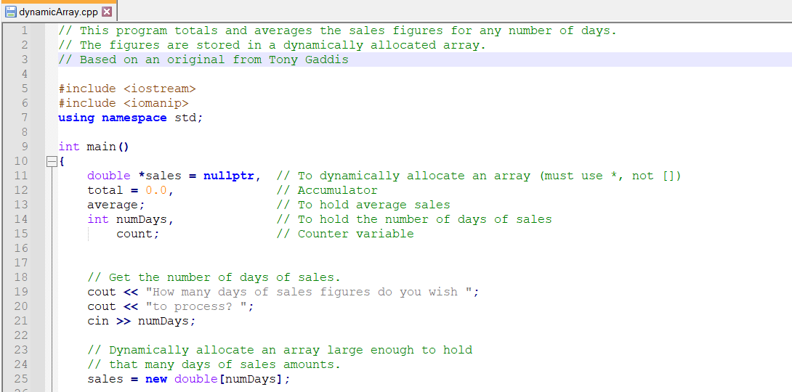
Dynamic Memory Allocation

Slide 11
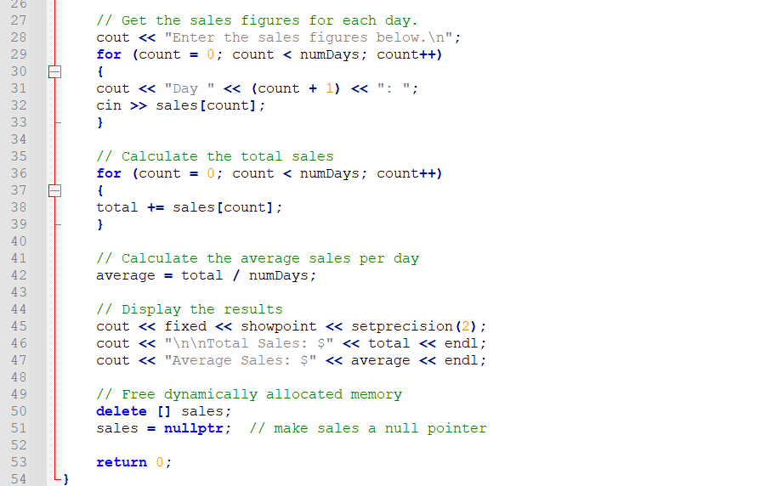
Dynamic Memory Allocation

Slide 12
RAII
Resource Acquisition Is Initialization (RAII)
Try to allocate resources in constructor (i.e. allocate memory from the heap)
Try to deallocate resources in destructor (i.e. deallocate memory from the heap)
We’ll discuss this more later.

Slide 13
Pointers to Structures
A structure variable has an address
Pointers to structures are variables that can hold the address of a structure:
Student *stuPtr;
Can use & operator to assign address:
stuPtr = &stu1;
Structure pointer can be a function parameter

Slide 14
Accessing Structure Members via Pointer Variables
Must use () to dereference pointer variable, not field within structure:
cout << (*stuPtr).studentID;
Can use structure pointer operator to eliminate () and use clearer notation:
cout << stuPtr->studentID;
Notes:
Compile dynamicStructure.cpp

Slide 15
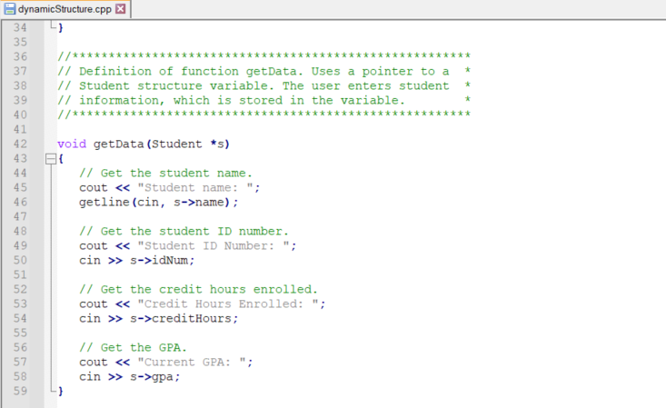
Code Segment showing use of structure pointers

Slide 16
CSCE 121 Introduction to Program Design & Concepts
Dynamic Memory Management
Dr. Tim McGuire
Grateful acknowledgment to Dr. Philip Ritchey and Dr. Michael Moore for some of the material on which these slides are based.

Slide 17
Memory Leaks
Lose access to memory allocated on the heap.
Easy to lose when dealing with pointers
We want to avoid!!!
Sometimes conflated with poor memory management.

Slide 18
Managing Memory
Programmer gets memory from the heap
Programmer must free it when done
Commonly referred to as garbage collection.
Good exam question
What are specific scenarios that can result in a memory leak?
Think about the definition of a memory leak as we continue to discuss dynamic memory management.

Slide 19
Strategies to Manage Dynamic Memory (i.e. do garbage collection)
Impractical
Avoid using dynamic memory.
Balance allocation with deallocation.
news with deletes
Automatic Garbage Collection
While these do exist for C++, tend to be inefficient and slow things down.
RAII – Resource Allocation is Initialization
When possible
allocate in the constructor
deallocate in the destructor
Too broad?
Inefficient, use a different language.
Preferred!

Slide 20
Resizing Arrays

Slide 21
For convenience, let’s put this in a struct
struct ResizableArray {
int size; // number of actual elements in the array
int capacity; // the current capacity of the array
int * data; // data points to the array containing the data
};

Slide 22
We can initialize our resizeable array thus:
ResizableArray a;
a.size = 0;
a.capacity = INITIAL_SIZE;
a.data = new int[a.capacity];

Slide 23
Now, let’s write code to add data to the array:
if(a.size < a.capacity) {
a.data[a.size] = val;
a.size++;
}
// but note that we have to handle the case if the array // becomes full

Slide 24
What do we do if the array becomes full?
We have to resize it.
That means allocate a new array and copy the original into it.
int *temp = new int[2 * a.capacity];
// copy the current values into the new array
for(int index = 0; index < a.size; index++)
temp[index] = a.data[index];
// free the original array
delete [] a.data;
// make a.data point to the new array and update the capacity
a.data = temp;
a.capacity = 2 * a.capacity;

Slide 25
resize-array.cpp

Slide 26
2D Dynamic Arrays Syntax

Slide 27
2D Dynamic Arrays Syntax
About
2D dynamic arrays are 1D dynamic arrays of 1D dynamic arrays.
A 2D dynamic array uses two pointer operators, **. E.g.,
int** grid = …;
double** values = …;
Traversing 2D dynamic arrays are identical to 2D static arrays.
A_{n}
…
A₁
A
<some value>
…
grid
A
A₁
<some value>
Stack
Heap

Slide 28
2D Dynamic Arrays Syntax
Details
Creating a 2D dynamic array requires two steps.
Step 1. Allocate a pointer to a dynamic array of pointers.
Step 2. Allocate each element of the dynamic array of pointers to another dynamic array of pointers.
A_{n}
…
A₁
A
grid
A
Stack
Heap

Slide 29
2D Dynamic Arrays Syntax
Details
Creating a 2D dynamic array requires two steps.
Step 1. Allocate a pointer to a dynamic array of pointers.
Step 2. Allocate each element of the dynamic array of pointers to another dynamic array of pointers.
A_{n}
…
A₁
A
<some value>
…
grid
A
A₁
<some value>
Stack
Heap

Slide 30
2D Dynamic Arrays Syntax
Syntax
// T: type; name: array identifier
// cap₁, cap₂: dimension capacities
// allocate 2D dynamic array
T** name = new T*[cap₁];
for (size_t i = 0; i < cap₁; ++i) {
name[i] = new T[cap₂];
}
// deallocate 2D dynamic array
for (size_t i = 0; i < cap₁; ++i) {
delete[] name[i];
}
delete[] T;
Example Syntax
// 3×5 grid of integers,
// defined as row major
// allocate 2D dynamic array
int** grid = new int*[5];
for (size_t i = 0; i < 5; ++i) {
grid[i] = new int[3];
}
// deallocate 2D dynamic array
for (size_t i = 0; i < 5; ++i) {
delete[] grid[i];
}
delete[] grid;

Slide 31
2D Dynamic Array Example with Built-in Data Type

Slide 32
2D Dynamic Array Example with Built-in Data Type
1 2 3 4 5 6 7 8 9 10 11 12 13 14 15 16 17 18 19 20 21 22 23 24 25 26 27 28 29 30 31 32 | #include <iostream> using std::cin, std::cout, std::endl; int main() { size_t width = 0; size_t height = 0; cout << "Enter width and height: "; cin >> width >> height; int** grid = new int*[height]; for (size_t y = 0; y < height; ++y) { grid[y] = new int[width]; } for (size_t y = 0; y < height; ++y) { for (size_t x = 0; x < width; ++x) { grid[y][x] = (x + 1) + (width * y); } } for (size_t y = 0; y < height; ++y) { for (size_t x = 0; x < width; ++x) { cout << grid[y][x] << " "; } cout << endl; } for (size_t y = 0; y < height; ++y) { delete[] grid[y]; } delete[] grid; }
About
The following program takes a 2D size from the console, and then displays an ascending sequence of numbers.
The number at the end of a line is continued at the start of the next line.
Detailed steps in next pages.

Slide 33
2D Dynamic Array Example with Built-in Data Type
1 2 3 4 5 6 7 8 9 10 11 12 13 14 15 16 17 18 19 20 21 22 23 24 25 26 27 28 29 30 31 32 | #include <iostream> using std::cin, std::cout, std::endl; int main() { size_t width = 0; size_t height = 0; cout << "Enter width and height: "; cin >> width >> height; int** grid = new int*[height]; for (size_t y = 0; y < height; ++y) { grid[y] = new int[width]; } for (size_t y = 0; y < height; ++y) { for (size_t x = 0; x < width; ++x) { grid[y][x] = (x + 1) + (width * y); } } for (size_t y = 0; y < height; ++y) { for (size_t x = 0; x < width; ++x) { cout << grid[y][x] << " "; } cout << endl; } for (size_t y = 0; y < height; ++y) { delete[] grid[y]; } delete[] grid; }
Lines 5 to 8. User enters 2D size.
Lines 10 to 13. 2D array is dynamically created.
Lines 15 to 19. The sequential number is calculated.
Lines 21 to 27. The sequential number is output to the console.
Lines 28 to 31. 2D array is deallocated.

Slide 34
2D Dynamic Array Example with Built-in Data Type
1 2 3 4 5 6 7 8 9 10 11 12 13 14 15 16 17 18 19 20 21 22 23 24 25 26 27 28 29 30 31 32 | #include <iostream> using std::cin, std::cout, std::endl; int main() { size_t width = 0; size_t height = 0; cout << "Enter width and height: "; cin >> width >> height; int** grid = new int*[height]; for (size_t y = 0; y < height; ++y) { grid[y] = new int[width]; } for (size_t y = 0; y < height; ++y) { for (size_t x = 0; x < width; ++x) { grid[y][x] = (x + 1) + (width * y); } } for (size_t y = 0; y < height; ++y) { for (size_t x = 0; x < width; ++x) { cout << grid[y][x] << " "; } cout << endl; } for (size_t y = 0; y < height; ++y) { delete[] grid[y]; } delete[] grid; }
Lines 5 to 8. User enters 2D size.
Lines 10 to 13. 2D array is dynamically created.
Lines 15 to 19. The sequential number is calculated.
Lines 21 to 27. The sequential number is output to the console.
Lines 28 to 31. 2D array is deallocated.

Slide 35
2D Dynamic Array Example with Built-in Data Type
1 2 3 4 5 6 7 8 9 10 11 12 13 14 15 16 17 18 19 20 21 22 23 24 25 26 27 28 29 30 31 32 | #include <iostream> using std::cin, std::cout, std::endl; int main() { size_t width = 0; size_t height = 0; cout << "Enter width and height: "; cin >> width >> height; int** grid = new int*[height]; for (size_t y = 0; y < height; ++y) { grid[y] = new int[width]; } for (size_t y = 0; y < height; ++y) { for (size_t x = 0; x < width; ++x) { grid[y][x] = (x + 1) + (width * y); } } for (size_t y = 0; y < height; ++y) { for (size_t x = 0; x < width; ++x) { cout << grid[y][x] << " "; } cout << endl; } for (size_t y = 0; y < height; ++y) { delete[] grid[y]; } delete[] grid; }
Lines 5 to 8. User enters 2D size.
Lines 10 to 13. 2D array is dynamically created.
Lines 15 to 19. The sequential number is calculated.
Lines 21 to 27. The sequential number is output to the console.
Lines 28 to 31. 2D array is deallocated.

Slide 36
2D Dynamic Array Example with Built-in Data Type
1 2 3 4 5 6 7 8 9 10 11 12 13 14 15 16 17 18 19 20 21 22 23 24 25 26 27 28 29 30 31 32 | #include <iostream> using std::cin, std::cout, std::endl; int main() { size_t width = 0; size_t height = 0; cout << "Enter width and height: "; cin >> width >> height; int** grid = new int*[height]; for (size_t y = 0; y < height; ++y) { grid[y] = new int[width]; } for (size_t y = 0; y < height; ++y) { for (size_t x = 0; x < width; ++x) { grid[y][x] = (x + 1) + (width * y); } } for (size_t y = 0; y < height; ++y) { for (size_t x = 0; x < width; ++x) { cout << grid[y][x] << " "; } cout << endl; } for (size_t y = 0; y < height; ++y) { delete[] grid[y]; } delete[] grid; }
Lines 5 to 8. User enters 2D size.
Lines 10 to 13. 2D array is dynamically created.
Lines 15 to 19. The sequential number is calculated.
Lines 21 to 27. The sequential number is output to the console.
Lines 28 to 31. 2D array is deallocated.

Slide 37
2D Dynamic Array Example with Built-in Data Type
1 2 3 4 5 6 7 8 9 10 11 12 13 14 15 16 17 18 19 20 21 22 23 24 25 26 27 28 29 30 31 32 | #include <iostream> using std::cin, std::cout, std::endl; int main() { size_t width = 0; size_t height = 0; cout << "Enter width and height: "; cin >> width >> height; int** grid = new int*[height]; for (size_t y = 0; y < height; ++y) { grid[y] = new int[width]; } for (size_t y = 0; y < height; ++y) { for (size_t x = 0; x < width; ++x) { grid[y][x] = (x + 1) + (width * y); } } for (size_t y = 0; y < height; ++y) { for (size_t x = 0; x < width; ++x) { cout << grid[y][x] << " "; } cout << endl; } for (size_t y = 0; y < height; ++y) { delete[] grid[y]; } delete[] grid; }
Lines 5 to 8. User enters 2D size.
Lines 10 to 13. 2D array is dynamically created.
Lines 15 to 19. The sequential number is calculated.
Lines 21 to 27. The sequential number is output to the console.
Lines 28 to 31. 2D array is deallocated.

Slide 38
2D Dynamic Array Example with Built-in Data Type
1 2 3 4 5 6 7 8 9 10 11 12 13 14 15 16 17 18 19 20 21 22 23 24 25 26 27 28 29 30 31 32 | #include <iostream> using std::cin, std::cout, std::endl; int main() { size_t width = 0; size_t height = 0; cout << "Enter width and height: "; cin >> width >> height; int** grid = new int*[height]; for (size_t y = 0; y < height; ++y) { grid[y] = new int[width]; } for (size_t y = 0; y < height; ++y) { for (size_t x = 0; x < width; ++x) { grid[y][x] = (x + 1) + (width * y); } } for (size_t y = 0; y < height; ++y) { for (size_t x = 0; x < width; ++x) { cout << grid[y][x] << " "; } cout << endl; } for (size_t y = 0; y < height; ++y) { delete[] grid[y]; } delete[] grid; }
Console Output
user@computer:/mnt/c/code$ ./a.out Enter width and height: 5 3
Heap

Slide 39
2D Dynamic Array Example with Built-in Data Type
1 2 3 4 5 6 7 8 9 10 11 12 13 14 15 16 17 18 19 20 21 22 23 24 25 26 27 28 29 30 31 32 | #include <iostream> using std::cin, std::cout, std::endl; int main() { size_t width = 0; size_t height = 0; cout << "Enter width and height: "; cin >> width >> height; int** grid = new int*[height]; for (size_t y = 0; y < height; ++y) { grid[y] = new int[width]; } for (size_t y = 0; y < height; ++y) { for (size_t x = 0; x < width; ++x) { grid[y][x] = (x + 1) + (width * y); } } for (size_t y = 0; y < height; ++y) { for (size_t x = 0; x < width; ++x) { cout << grid[y][x] << " "; } cout << endl; } for (size_t y = 0; y < height; ++y) { delete[] grid[y]; } delete[] grid; }
Console Output
user@computer:/mnt/c/code$ ./a.out Enter width and height: 5 3
???
???
grid
???
Heap

Slide 40
2D Dynamic Array Example with Built-in Data Type
1 2 3 4 5 6 7 8 9 10 11 12 13 14 15 16 17 18 19 20 21 22 23 24 25 26 27 28 29 30 31 32 | #include <iostream> using std::cin, std::cout, std::endl; int main() { size_t width = 0; size_t height = 0; cout << "Enter width and height: "; cin >> width >> height; int** grid = new int*[height]; for (size_t y = 0; y < height; ++y) { grid[y] = new int[width]; } for (size_t y = 0; y < height; ++y) { for (size_t x = 0; x < width; ++x) { grid[y][x] = (x + 1) + (width * y); } } for (size_t y = 0; y < height; ++y) { for (size_t x = 0; x < width; ++x) { cout << grid[y][x] << " "; } cout << endl; } for (size_t y = 0; y < height; ++y) { delete[] grid[y]; } delete[] grid; }
Console Output
user@computer:/mnt/c/code$ ./a.out Enter width and height: 5 3
???
???
grid
A
A
???
???
???
???
???
Heap

Slide 41
2D Dynamic Array Example with Built-in Data Type
1 2 3 4 5 6 7 8 9 10 11 12 13 14 15 16 17 18 19 20 21 22 23 24 25 26 27 28 29 30 31 32 | #include <iostream> using std::cin, std::cout, std::endl; int main() { size_t width = 0; size_t height = 0; cout << "Enter width and height: "; cin >> width >> height; int** grid = new int*[height]; for (size_t y = 0; y < height; ++y) { grid[y] = new int[width]; } for (size_t y = 0; y < height; ++y) { for (size_t x = 0; x < width; ++x) { grid[y][x] = (x + 1) + (width * y); } } for (size_t y = 0; y < height; ++y) { for (size_t x = 0; x < width; ++x) { cout << grid[y][x] << " "; } cout << endl; } for (size_t y = 0; y < height; ++y) { delete[] grid[y]; } delete[] grid; }
Console Output
user@computer:/mnt/c/code$ ./a.out Enter width and height: 5 3
???
B
???
???
???
???
???
B
grid
A
A
???
???
???
???
???
Heap

Slide 42
2D Dynamic Array Example with Built-in Data Type
1 2 3 4 5 6 7 8 9 10 11 12 13 14 15 16 17 18 19 20 21 22 23 24 25 26 27 28 29 30 31 32 | #include <iostream> using std::cin, std::cout, std::endl; int main() { size_t width = 0; size_t height = 0; cout << "Enter width and height: "; cin >> width >> height; int** grid = new int*[height]; for (size_t y = 0; y < height; ++y) { grid[y] = new int[width]; } for (size_t y = 0; y < height; ++y) { for (size_t x = 0; x < width; ++x) { grid[y][x] = (x + 1) + (width * y); } } for (size_t y = 0; y < height; ++y) { for (size_t x = 0; x < width; ++x) { cout << grid[y][x] << " "; } cout << endl; } for (size_t y = 0; y < height; ++y) { delete[] grid[y]; } delete[] grid; }
Console Output
user@computer:/mnt/c/code$ ./a.out Enter width and height: 5 3
C
???
???
???
???
???
C
B
???
???
???
???
???
B
grid
A
A
???
???
???
???
???
Heap

Slide 43
2D Dynamic Array Example with Built-in Data Type
1 2 3 4 5 6 7 8 9 10 11 12 13 14 15 16 17 18 19 20 21 22 23 24 25 26 27 28 29 30 31 32 | #include <iostream> using std::cin, std::cout, std::endl; int main() { size_t width = 0; size_t height = 0; cout << "Enter width and height: "; cin >> width >> height; int** grid = new int*[height]; for (size_t y = 0; y < height; ++y) { grid[y] = new int[width]; } for (size_t y = 0; y < height; ++y) { for (size_t x = 0; x < width; ++x) { grid[y][x] = (x + 1) + (width * y); } } for (size_t y = 0; y < height; ++y) { for (size_t x = 0; x < width; ++x) { cout << grid[y][x] << " "; } cout << endl; } for (size_t y = 0; y < height; ++y) { delete[] grid[y]; } delete[] grid; }
Console Output
user@computer:/mnt/c/code$ ./a.out Enter width and height: 5 3
C
???
???
???
???
???
C
B
???
???
???
???
???
B
grid
A
A
1
2
3
4
5
Heap

Slide 44
2D Dynamic Array Example with Built-in Data Type
1 2 3 4 5 6 7 8 9 10 11 12 13 14 15 16 17 18 19 20 21 22 23 24 25 26 27 28 29 30 31 32 | #include <iostream> using std::cin, std::cout, std::endl; int main() { size_t width = 0; size_t height = 0; cout << "Enter width and height: "; cin >> width >> height; int** grid = new int*[height]; for (size_t y = 0; y < height; ++y) { grid[y] = new int[width]; } for (size_t y = 0; y < height; ++y) { for (size_t x = 0; x < width; ++x) { grid[y][x] = (x + 1) + (width * y); } } for (size_t y = 0; y < height; ++y) { for (size_t x = 0; x < width; ++x) { cout << grid[y][x] << " "; } cout << endl; } for (size_t y = 0; y < height; ++y) { delete[] grid[y]; } delete[] grid; }
Console Output
user@computer:/mnt/c/code$ ./a.out Enter width and height: 5 3
C
???
???
???
???
???
C
B
6
7
8
9
10
B
grid
A
A
1
2
3
4
5
Heap

Slide 45
2D Dynamic Array Example with Built-in Data Type
1 2 3 4 5 6 7 8 9 10 11 12 13 14 15 16 17 18 19 20 21 22 23 24 25 26 27 28 29 30 31 32 | #include <iostream> using std::cin, std::cout, std::endl; int main() { size_t width = 0; size_t height = 0; cout << "Enter width and height: "; cin >> width >> height; int** grid = new int*[height]; for (size_t y = 0; y < height; ++y) { grid[y] = new int[width]; } for (size_t y = 0; y < height; ++y) { for (size_t x = 0; x < width; ++x) { grid[y][x] = (x + 1) + (width * y); } } for (size_t y = 0; y < height; ++y) { for (size_t x = 0; x < width; ++x) { cout << grid[y][x] << " "; } cout << endl; } for (size_t y = 0; y < height; ++y) { delete[] grid[y]; } delete[] grid; }
Console Output
user@computer:/mnt/c/code$ ./a.out Enter width and height: 5 3
C
11
12
13
14
15
C
B
6
7
8
9
10
B
grid
A
A
1
2
3
4
5
Heap

Slide 46
2D Dynamic Array Example with Built-in Data Type
1 2 3 4 5 6 7 8 9 10 11 12 13 14 15 16 17 18 19 20 21 22 23 24 25 26 27 28 29 30 31 32 | #include <iostream> using std::cin, std::cout, std::endl; int main() { size_t width = 0; size_t height = 0; cout << "Enter width and height: "; cin >> width >> height; int** grid = new int*[height]; for (size_t y = 0; y < height; ++y) { grid[y] = new int[width]; } for (size_t y = 0; y < height; ++y) { for (size_t x = 0; x < width; ++x) { grid[y][x] = (x + 1) + (width * y); } } for (size_t y = 0; y < height; ++y) { for (size_t x = 0; x < width; ++x) { cout << grid[y][x] << " "; } cout << endl; } for (size_t y = 0; y < height; ++y) { delete[] grid[y]; } delete[] grid; }
Console Output
user@computer:/mnt/c/code$ ./a.out Enter width and height: 5 3 1 2 3 4 5
C
11
12
13
14
15
C
B
6
7
8
9
10
B
grid
A
A
1
2
3
4
5

Slide 47
2D Dynamic Array Example with Built-in Data Type
1 2 3 4 5 6 7 8 9 10 11 12 13 14 15 16 17 18 19 20 21 22 23 24 25 26 27 28 29 30 31 32 | #include <iostream> using std::cin, std::cout, std::endl; int main() { size_t width = 0; size_t height = 0; cout << "Enter width and height: "; cin >> width >> height; int** grid = new int*[height]; for (size_t y = 0; y < height; ++y) { grid[y] = new int[width]; } for (size_t y = 0; y < height; ++y) { for (size_t x = 0; x < width; ++x) { grid[y][x] = (x + 1) + (width * y); } } for (size_t y = 0; y < height; ++y) { for (size_t x = 0; x < width; ++x) { cout << grid[y][x] << " "; } cout << endl; } for (size_t y = 0; y < height; ++y) { delete[] grid[y]; } delete[] grid; }
Console Output
user@computer:/mnt/c/code$ ./a.out Enter width and height: 5 3 1 2 3 4 5 6 7 8 9 10
C
11
12
13
14
15
C
B
6
7
8
9
10
B
grid
A
A
1
2
3
4
5

Slide 48
2D Dynamic Array Example with Built-in Data Type
1 2 3 4 5 6 7 8 9 10 11 12 13 14 15 16 17 18 19 20 21 22 23 24 25 26 27 28 29 30 31 32 | #include <iostream> using std::cin, std::cout, std::endl; int main() { size_t width = 0; size_t height = 0; cout << "Enter width and height: "; cin >> width >> height; int** grid = new int*[height]; for (size_t y = 0; y < height; ++y) { grid[y] = new int[width]; } for (size_t y = 0; y < height; ++y) { for (size_t x = 0; x < width; ++x) { grid[y][x] = (x + 1) + (width * y); } } for (size_t y = 0; y < height; ++y) { for (size_t x = 0; x < width; ++x) { cout << grid[y][x] << " "; } cout << endl; } for (size_t y = 0; y < height; ++y) { delete[] grid[y]; } delete[] grid; }
Console Output
user@computer:/mnt/c/code$ ./a.out Enter width and height: 5 3 1 2 3 4 5 6 7 8 9 10 11 12 13 14 15
C
11
12
13
14
15
C
B
6
7
8
9
10
B
grid
A
A
1
2
3
4
5

Slide 49
2D Dynamic Array Example with Built-in Data Type
1 2 3 4 5 6 7 8 9 10 11 12 13 14 15 16 17 18 19 20 21 22 23 24 25 26 27 28 29 30 31 32 | #include <iostream> using std::cin, std::cout, std::endl; int main() { size_t width = 0; size_t height = 0; cout << "Enter width and height: "; cin >> width >> height; int** grid = new int*[height]; for (size_t y = 0; y < height; ++y) { grid[y] = new int[width]; } for (size_t y = 0; y < height; ++y) { for (size_t x = 0; x < width; ++x) { grid[y][x] = (x + 1) + (width * y); } } for (size_t y = 0; y < height; ++y) { for (size_t x = 0; x < width; ++x) { cout << grid[y][x] << " "; } cout << endl; } for (size_t y = 0; y < height; ++y) { delete[] grid[y]; } delete[] grid; }
Console Output
user@computer:/mnt/c/code$ ./a.out Enter width and height: 5 3 1 2 3 4 5 6 7 8 9 10 11 12 13 14 15
C
11
12
13
14
15
C
B
6
7
8
9
10
B
grid
A
A
1
2
3
4
5

Slide 50
2D Dynamic Array Example with Built-in Data Type
1 2 3 4 5 6 7 8 9 10 11 12 13 14 15 16 17 18 19 20 21 22 23 24 25 26 27 28 29 30 31 32 | #include <iostream> using std::cin, std::cout, std::endl; int main() { size_t width = 0; size_t height = 0; cout << "Enter width and height: "; cin >> width >> height; int** grid = new int*[height]; for (size_t y = 0; y < height; ++y) { grid[y] = new int[width]; } for (size_t y = 0; y < height; ++y) { for (size_t x = 0; x < width; ++x) { grid[y][x] = (x + 1) + (width * y); } } for (size_t y = 0; y < height; ++y) { for (size_t x = 0; x < width; ++x) { cout << grid[y][x] << " "; } cout << endl; } for (size_t y = 0; y < height; ++y) { delete[] grid[y]; } delete[] grid; }
Console Output
user@computer:/mnt/c/code$ ./a.out Enter width and height: 5 3 1 2 3 4 5 6 7 8 9 10 11 12 13 14 15
C
11
12
13
14
15
C
B
6
7
8
9
10
B
grid
A
A
1
2
3
4
5

Slide 51
2D Dynamic Array Example with Built-in Data Type
1 2 3 4 5 6 7 8 9 10 11 12 13 14 15 16 17 18 19 20 21 22 23 24 25 26 27 28 29 30 31 32 | #include <iostream> using std::cin, std::cout, std::endl; int main() { size_t width = 0; size_t height = 0; cout << "Enter width and height: "; cin >> width >> height; int** grid = new int*[height]; for (size_t y = 0; y < height; ++y) { grid[y] = new int[width]; } for (size_t y = 0; y < height; ++y) { for (size_t x = 0; x < width; ++x) { grid[y][x] = (x + 1) + (width * y); } } for (size_t y = 0; y < height; ++y) { for (size_t x = 0; x < width; ++x) { cout << grid[y][x] << " "; } cout << endl; } for (size_t y = 0; y < height; ++y) { delete[] grid[y]; } delete[] grid; }
Console Output
user@computer:/mnt/c/code$ ./a.out Enter width and height: 5 3 1 2 3 4 5 6 7 8 9 10 11 12 13 14 15
C
11
12
13
14
15
C
B
6
7
8
9
10
B
grid
A
A
1
2
3
4
5

Slide 52
2D Dynamic Array Example with Built-in Data Type
1 2 3 4 5 6 7 8 9 10 11 12 13 14 15 16 17 18 19 20 21 22 23 24 25 26 27 28 29 30 31 32 | #include <iostream> using std::cin, std::cout, std::endl; int main() { size_t width = 0; size_t height = 0; cout << "Enter width and height: "; cin >> width >> height; int** grid = new int*[height]; for (size_t y = 0; y < height; ++y) { grid[y] = new int[width]; } for (size_t y = 0; y < height; ++y) { for (size_t x = 0; x < width; ++x) { grid[y][x] = (x + 1) + (width * y); } } for (size_t y = 0; y < height; ++y) { for (size_t x = 0; x < width; ++x) { cout << grid[y][x] << " "; } cout << endl; } for (size_t y = 0; y < height; ++y) { delete[] grid[y]; } delete[] grid; }
Console Output
user@computer:/mnt/c/code$ ./a.out Enter width and height: 5 3 1 2 3 4 5 6 7 8 9 10 11 12 13 14 15
C
11
12
13
14
15
C
B
6
7
8
9
10
B
grid
A
A
1
2
3
4
5

Slide 53
2D Dynamic Array Example with Built-in Data Type
1 2 3 4 5 6 7 8 9 10 11 12 13 14 15 16 17 18 19 20 21 22 23 24 25 26 27 28 29 30 31 32 | #include <iostream> using std::cin, std::cout, std::endl; int main() { size_t width = 0; size_t height = 0; cout << "Enter width and height: "; cin >> width >> height; int** grid = new int*[height]; for (size_t y = 0; y < height; ++y) { grid[y] = new int[width]; } for (size_t y = 0; y < height; ++y) { for (size_t x = 0; x < width; ++x) { grid[y][x] = (x + 1) + (width * y); } } for (size_t y = 0; y < height; ++y) { for (size_t x = 0; x < width; ++x) { cout << grid[y][x] << " "; } cout << endl; } for (size_t y = 0; y < height; ++y) { delete[] grid[y]; } delete[] grid; }
Console Output
user@computer:/mnt/c/code$ ./a.out Enter width and height: 5 3 1 2 3 4 5 6 7 8 9 10 11 12 13 14 15 user@computer:/mnt/c/code$
C
11
12
13
14
15
C
B
6
7
8
9
10
B
grid
A
A
1
2
3
4
5

